Slide 1
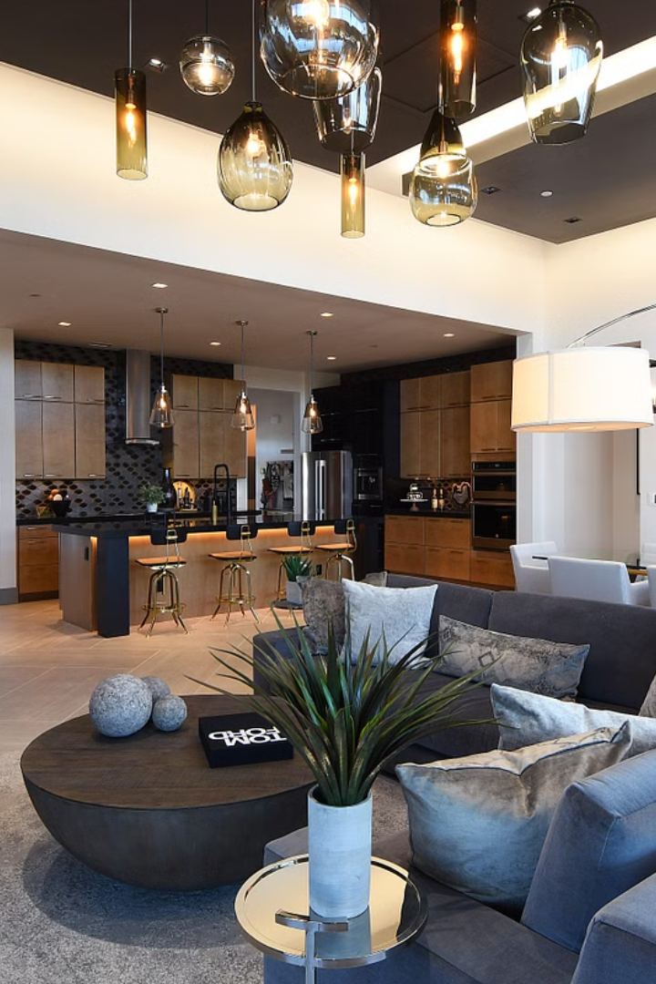
SMART HOME
AUTOMATION SYSTEM
Smart home systems are revolutionizing the way we live, offering increased convenience, energy efficiency, and security through the integration of connected devices and intelligent automation.

Slide 2
Smart Home System Idea
Seamless Integration
Voice Control
Remote Access
Our smart home system seamlessly integrates various devices, sensors, and home automation technologies to create a cohesive and user-friendly experience.
Intuitive voice commands allow users to effortlessly control their home environment, from adjusting the thermostat to turning on lights.
Homeowners can remotely monitor and manage their home using a smartphone or tablet, providing peace of mind and convenience.

Slide 3
Smart Home Market
1
Rapid Growth
The global smart home market is projected to grow at a CAGR of over 15% from 2021 to 2026, driven by increasing demand for connected home technologies.
2
Adoption Trends
Millennials and tech-savvy consumers are leading the charge in smart home adoption, seeking to enhance their quality of life and reduce energy costs.
3
Emerging Opportunities
The rise of 5G, AI, and IoT technologies is unlocking new possibilities for advanced smart home features and functionalities.

Slide 4
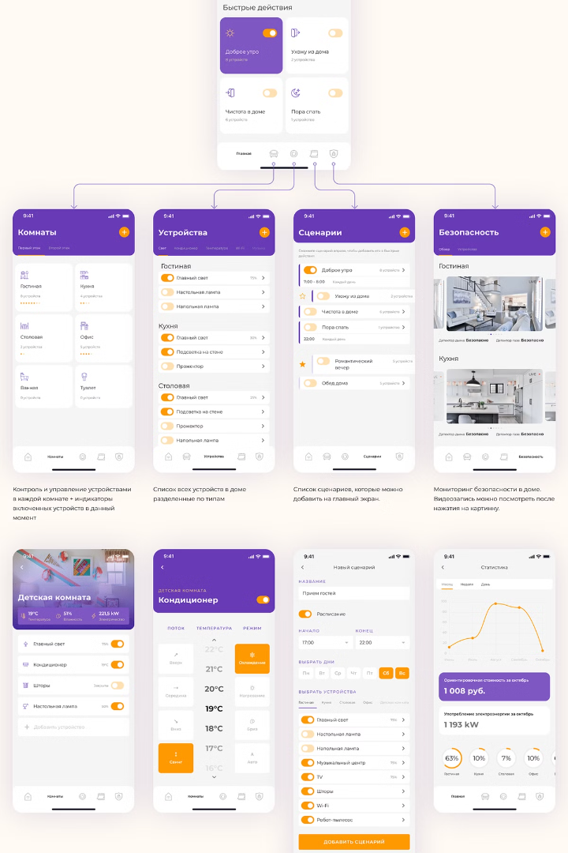
Smart Home System Research
1
Comprehensive Analysis
2
Technological Trends
Our research team has conducted in-depth market analysis, user surveys, and competitive benchmarking to identify key pain points and opportunities in the smart home space.
We closely monitor emerging technologies, industry standards, and consumer preferences to ensure our smart home solution remains at the forefront of innovation.
3
User-Centric Design
By prioritizing user experience and feedback, we are developing a smart home system that is intuitive, reliable, and tailored to the needs of modern households.

Slide 5
Problem Statement
Manual operation of household appliances is inefficient, leading to energy and resource wastage. Additionally, safety hazards like gas leaks remain undetected in traditional homes. This project addresses these challenges through automation.

Slide 6





Existing Solutions
Google Home
Amazon Alexa
Apple HomeKit
Samsung SmartThings
Voice-controlled smart home assistant with integration for a variety of connected devices.
Popular AI-powered virtual assistant that can control smart home features and perform various tasks.
Apple's platform for integrating and controlling a wide range of smart home accessories.
Comprehensive smart home platform that supports a broad ecosystem of connected devices.

Slide 7

Existing Companies
Company
Product Focus
Strengths
Nest
Thermostats, Cameras, Alarms
Sleek design, advanced features, Google integration
Ecobee
Thermostats, Sensors, Cameras
Voice control, remote access, energy efficiency
Philips Hue
Lighting, Bulbs, Fixtures
Wide product range, customizable lighting, app control
Ring
Video Doorbells, Security Cameras
Easy installation, mobile app integration, Amazon Alexa support

Slide 8
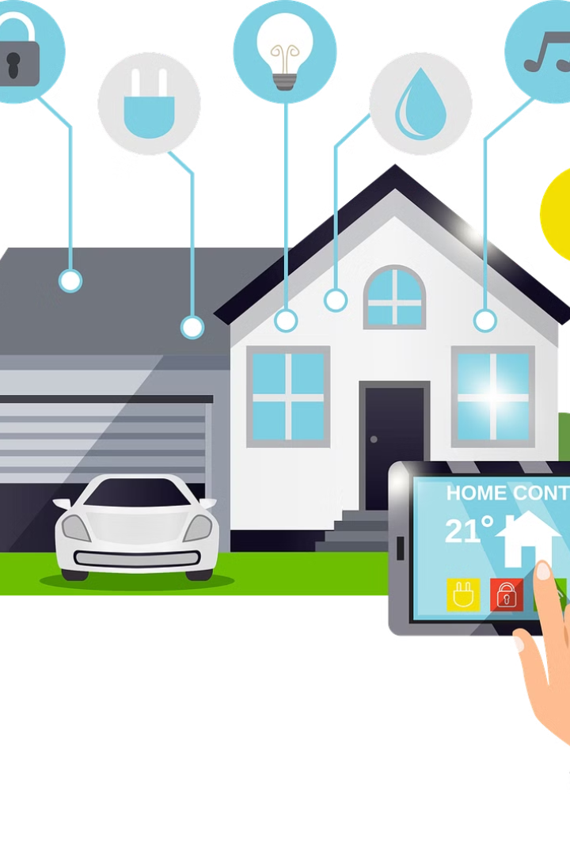
Our Smart Home Solution
Comprehensive Integration
Intelligent Automation
Advanced algorithms and machine learning enable our system to learn user preferences and automate various home functions for improved efficiency and convenience.
Our smart home system seamlessly connects a wide range of devices, including lighting, climate control, security, and entertainment systems.
Robust Security
User-Friendly Interface
Robust encryption, biometric authentication, and real-time monitoring ensure the safety and privacy of our customers' homes and data.
The intuitive mobile app and voice control capabilities provide a seamless and accessible user experience for all members of the household.

Slide 9
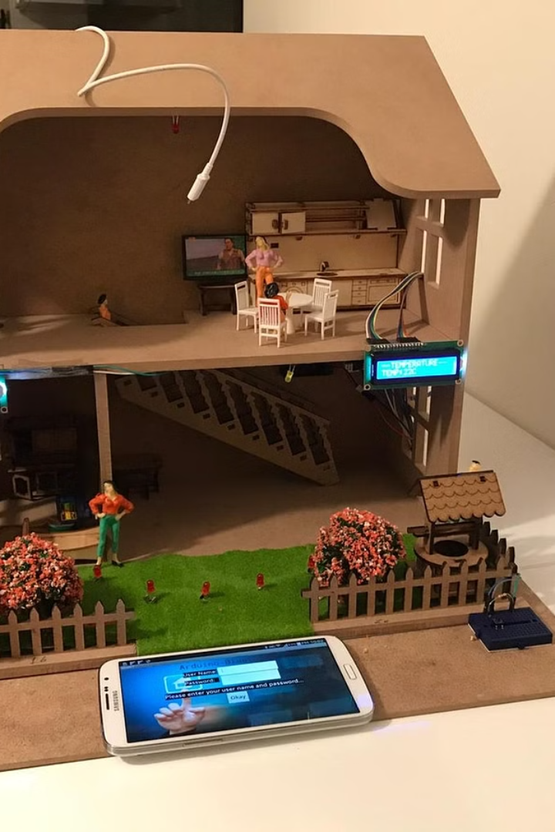



Our Prototype
Device Integration
Our prototype seamlessly connects a wide range of smart home devices, including lights, thermostats, security cameras, and entertainment systems.
Automation Routines
Homeowners can create custom automation routines to automate various home functions, such as turning off lights and locking doors when leaving.
Voice Control
Users can control their smart home features using voice commands, providing a hands-free and intuitive way to manage their living environment.

Slide 10
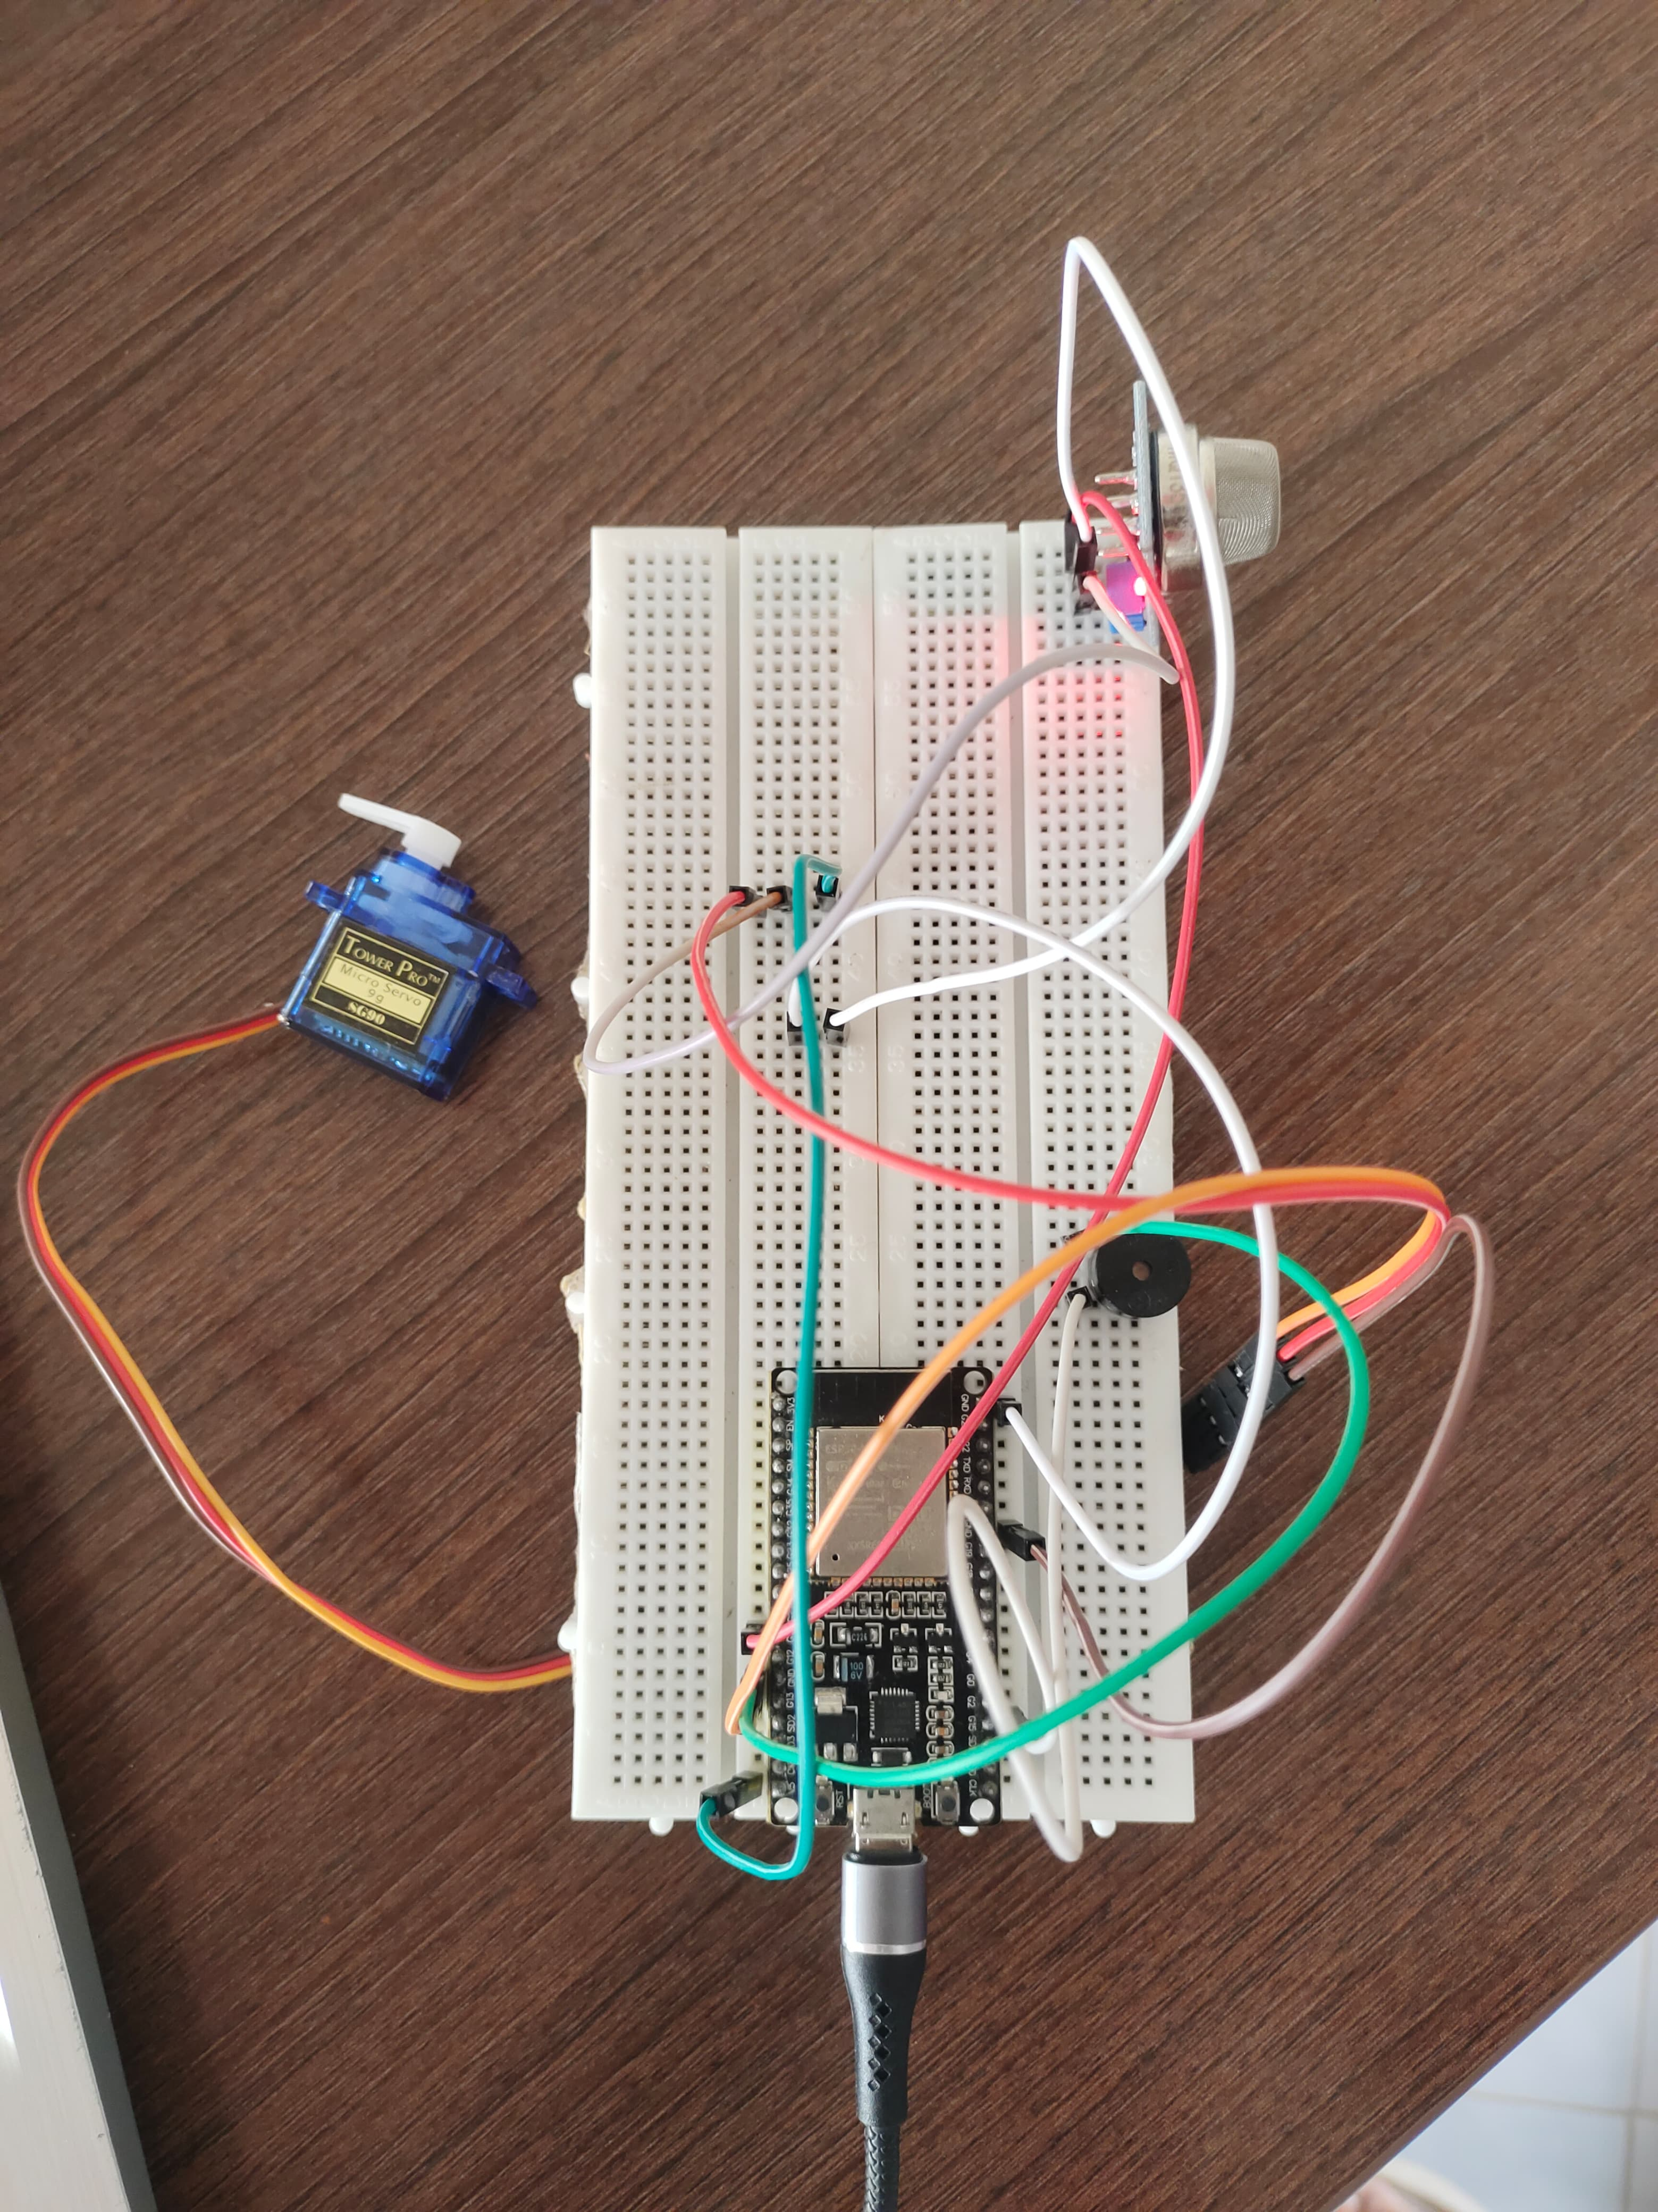
#include <ESP32Servo.h>
#define DO_PIN 14 // ESP32's pin GPIO14 connected to DO pin of the MQ2 sensor
#define BUZZER_PIN 15 // Pin connected to the buzzer
#define SERVO_PIN 13 // Pin connected to the servoServo topServo; // Create a servo objectvoid setup() { Serial.begin(9600); pinMode(DO_PIN, INPUT);
pinMode(BUZZER_PIN, OUTPUT);
topServo.attach(SERVO_PIN);
// Attaches the servo on pin SERVO_PIN to the servo object Serial.println("Warming up the MQ2 sensor"); delay(20000);
// wait for the MQ2 to warm up}56tg int gasState = digitalRead(DO_PIN); if (gasState == HIGH) { Serial.println("The gas is NOT present");
// Turn off the buzzer digitalWrite(BUZZER_PIN, LOW);
// Move the servo to its initial position topServo.write(0); } else { Serial.println("The gas is present");
// Turn on the buzzer digitalWrite(BUZZER_PIN, HIGH);
// Move the servo to a specific position topServo.write(180); delay(1000);
// Wait for the servo to reach its position topServo.write(0);
// Move the servo back to its initial position } delay(1000);
// Adjust delay as needed}

Slide 11
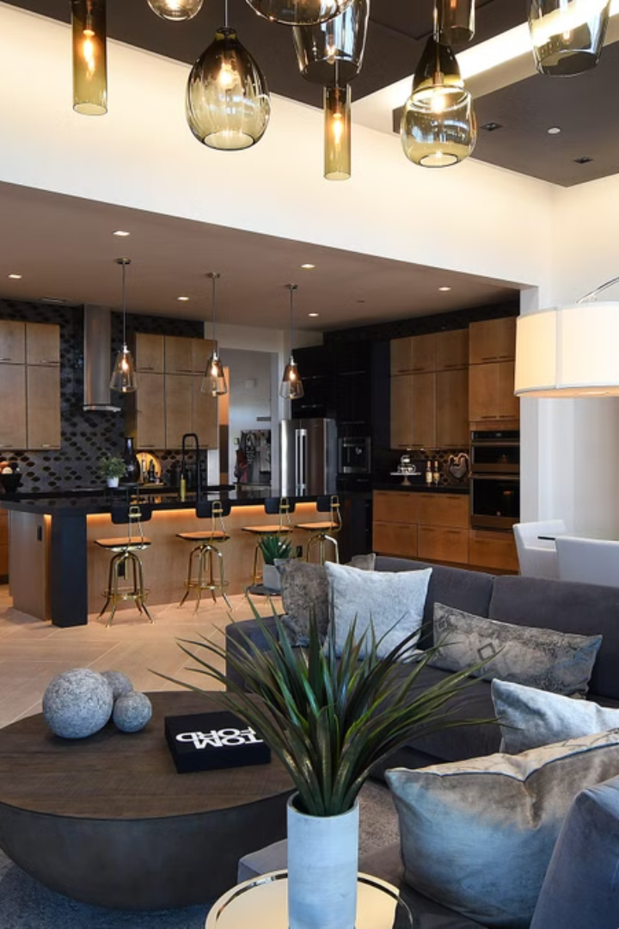
Conclusion
As the smart home market continues to evolve, our comprehensive and user-centric solution is poised to revolutionize the way people interact with and manage their living spaces. With a focus on seamless integration, intelligent automation, and robust security, we are committed to delivering a truly transformative smart home experience.

